Slide 1

Predicting customer buying behaviour
17/07/2023

Slide 2
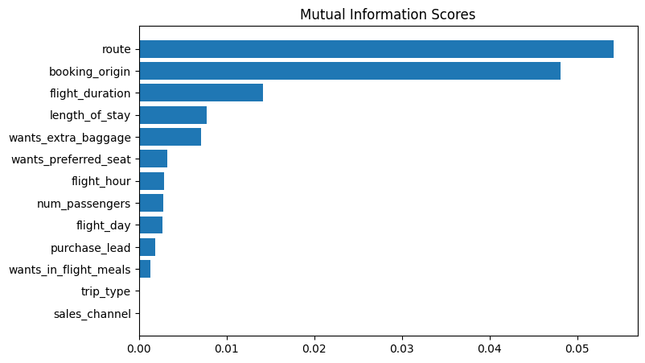
predictive model to understand factors that influence buying behaviour
Having trained with different models, Random Forest Classifier was chosen as the best with:
ACCURACY: 85.37
AUC score: 0.567
I also noticed that
route
booking_origin
flight_duration
length_of_stay
wants_extra_baggage
are the top 5 features which influence
Customer buying behavior
The AUC score is low, so it needs to be increased.

